Slide 1

Who Drowns First?
- Adriano Yoshino, Hrafnkell Hjorleifsson, Akshay Penmatcha & Christian

Slide 2
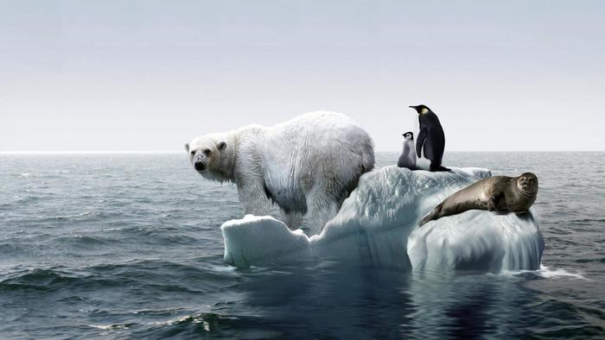
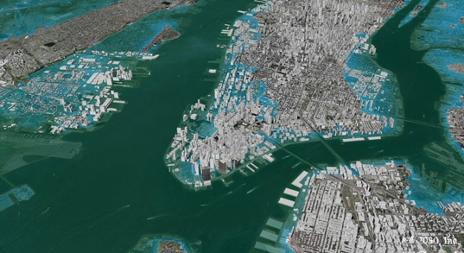
MOTIVATION
Global Warming
Sea-Level Rise
Melting Snow Caps
Risk to low-lying coastal cities

Slide 3



DATA SOURCES
Census Tract Data
Elevation Data
Flood Maps

Slide 4
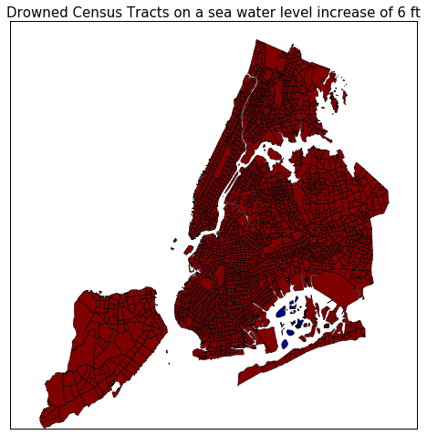
MAPS

Slide 5

MAPS

Slide 6
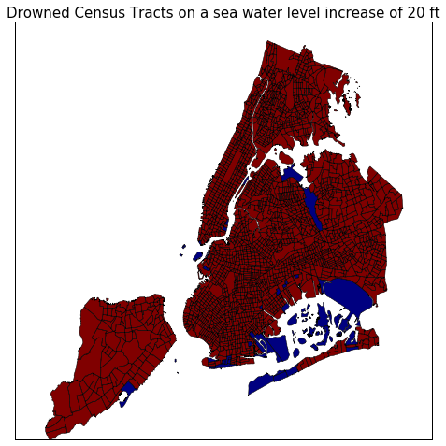
MAPS

Slide 7
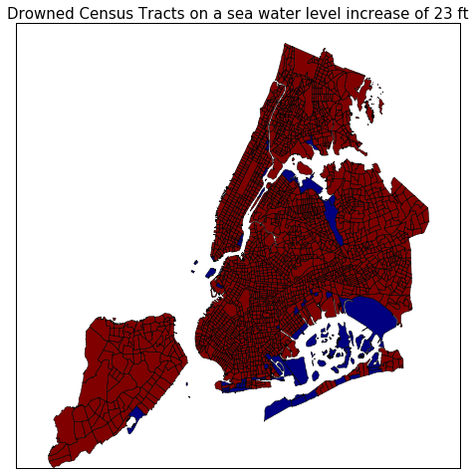
MAPS

Slide 8
MAPS

Slide 9
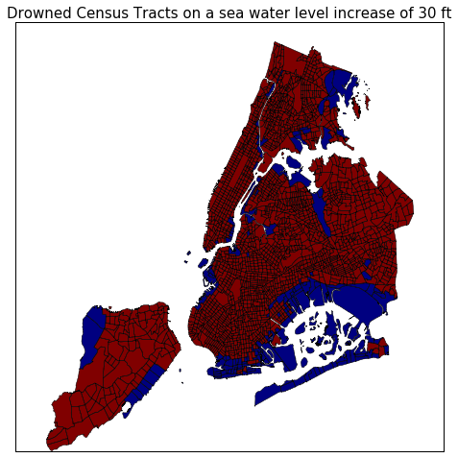
MAPS

Slide 10
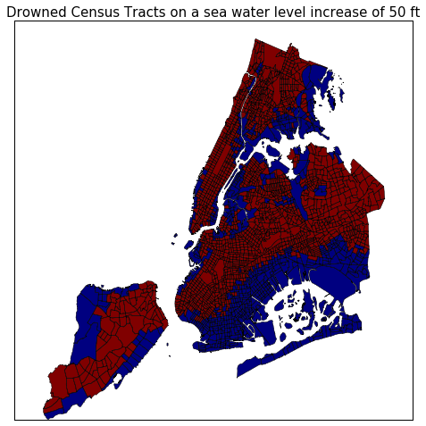
MAPS

Slide 11

MAPS

Slide 12
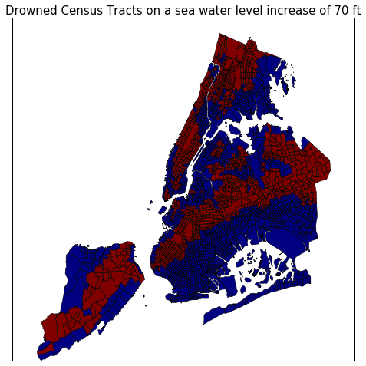
MAPS

Slide 13
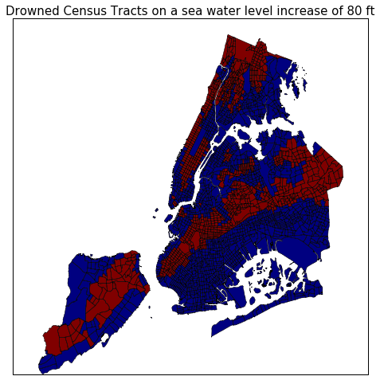
MAPS

Slide 14
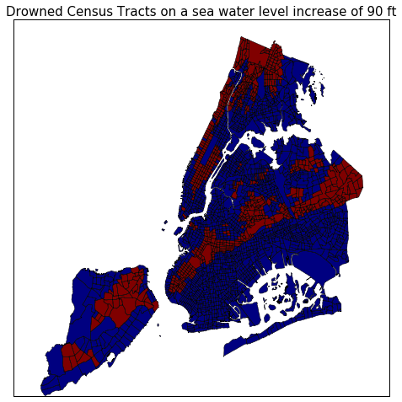
MAPS

Slide 15
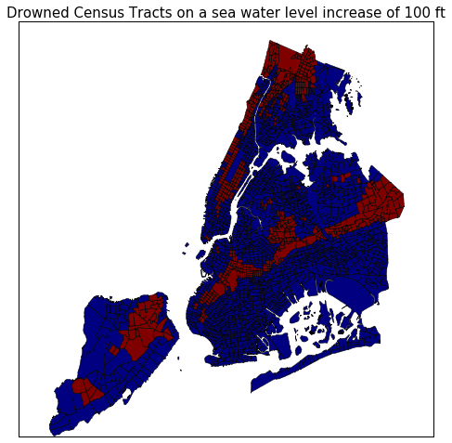
MAPS

Slide 16
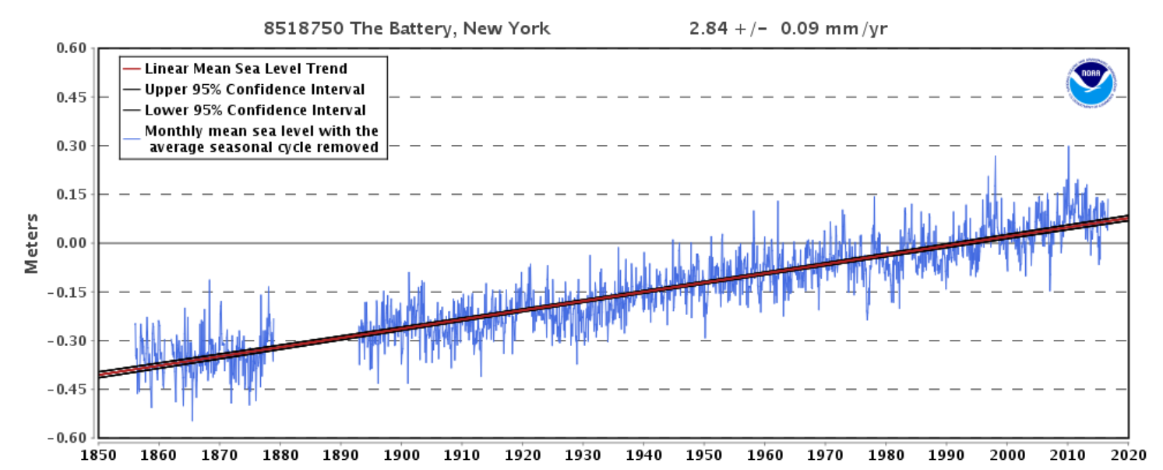
PREDICTED RISE IN FUTURE
The mean sea level trend is 2.84 millimeters/year

Slide 17
LIMITATIONS
Grouping by Census Tract
Average elevation of census tracts was used
Disconnected low-lying areas

